Slide 1

NEWS ARTICLE SUMMARIZATION
Team Members:
Raghavendra Reddy Paluri.
Yogishwar Reddy Karumulla.

Slide 2
Objective:
To automatically generate a concise and coherent summary of a news article with long context.
To develop a model that can accurately and efficiently summarize news articles.

Slide 3
Introduction
News article summarization is a crucial task in natural language processing and has a wide range of applications in the field of information retrieval, content recommendation, and data analysis.
It is an exciting and rapidly evolving field that has the potential to revolutionize the way we consume and process news content.

Slide 4
Advantages
Efficient information retrieval.
Facilitate automatic text analysis.
Easily understandable.
Helps in saving time.

Slide 5
Approach
DATA COLLECTION
PRE-PROCESSING
PRE-TRAINED MODEL SELECTION
TRANSFER LEARNING
TRAINING
TESTING
SUMMARIZATION
EVALUATION
ITERATION.

Slide 6
Dataset
We created a custom dataset by downloading information from various sources like Wikipedia, google, and some famous news article websites.
The Dataset consists 650k rows(approx.) of text in train and 11k(approx.) of text in test

Slide 7
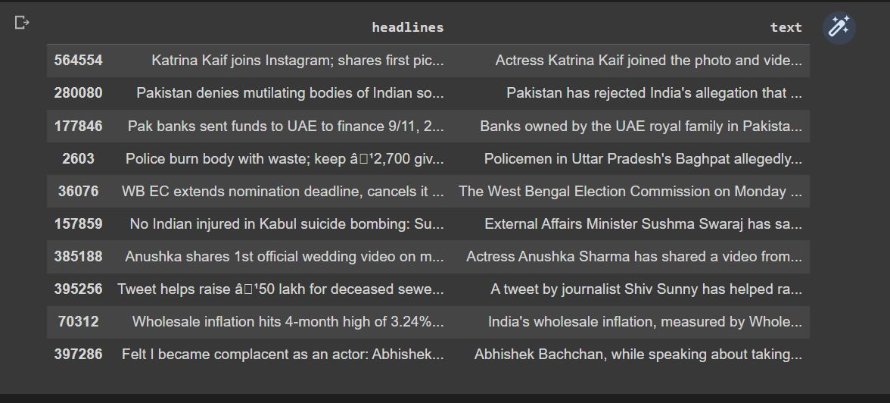
Dataset

Slide 8

Tools:
NLTK
Python 3
Google Colab
Transformers
BART/T-5

Slide 9

Evaluation Methodology:
Automatic Evaluation:
Metrics such as ROUGE, BLEU, and METEOR can be used to compare the generated summaries with the reference summaries.
These metrics are commonly used to evaluate the quality of machine-generated summaries and can provide a quantitative measure of performance.

Slide 10
RESULT
The ROUGE score is utilized to compute the number of matching words between the generated summary and the reference sentences, relative to the total count of words in the reference sentences.
The resulting ROUGE score falls between 0 and 1, with a score of 1 indicating an exact match between the sentences, while scores lower than 1 indicate some degree of dissimilarity.

Slide 11
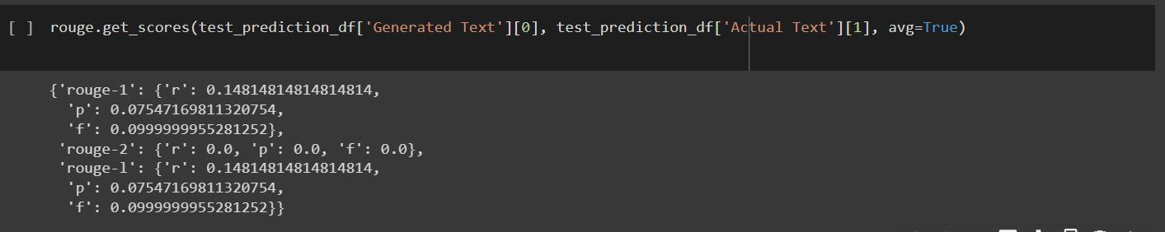
RESULT

Slide 12
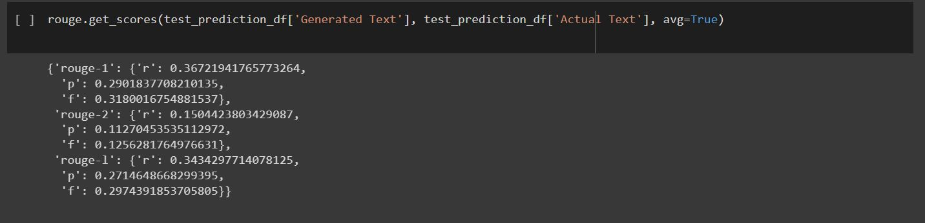
RESULT

Slide 13

References:
https://towardsdatascience.com/t5-a-model-that-explores-the-limits-of-transfer-learning-fb29844890b7
https://towardsdatascience.com/text-summarization-with-nlp-textrank-vs-seq2seq-vs-bart-474943efeb09
https://github.com/huggingface/transformers
https://arxiv.org/abs/1910.10683
https://huggingface.co/docs/transformers/model_doc/bart

